Slide 1
Title: Deep Learning Model for Big Data Classification in Apache Spark Environment
AUTHORS-T. M. Nithya, R.Umanesan, T. Kalavathidevi, C. Selvarathi and A.Kavith
122AD0057 –SHASHI KUMAR
122AD0058 –GNANESWAR
122AD0040 –SRI SAI NADH

Slide 2
CONTENTS:
Problem Statement
Introduction
Literature Survey
Research Gaps & Limitations
Proposed methods
Experimentation
FUTURE WORK
References

Slide 3
Problem Statement
Big data is rapidly growing, requiring efficient classification techniques.
Traditional machine learning models such as SVM, Logistic Regression, and Naïve Bayes struggle with large-scale datasets.
Feature selection is essential for improving accuracy and reducing computational costs.
Apache Spark provides distributed processing but has limitations in classification efficiency.
Need for an optimized approach combining feature selection and deep learning for better performance

Slide 4
Introduction to Big Data Analytics
Big Data Analytics: The process of analyzing large datasets to extract insights.
Challenges: 1)High-dimensional data 2)Long processing times
3)Inefficiency of traditional classifiers
Apache Spark: A distributed computing framework that enables scalable data processing.
Proposed Model: SBOA-OGRU, which integrates:
Sigmoid Butterfly Optimization Algorithm (SBOA) for feature selection.
Optimized Gated Recurrent Unit (OGRU) for classification.

Slide 5
Literature Survey
Existing Approaches:
Feature selection methods such as PCA, Genetic Algorithm, and Particle Swarm Optimization.
Traditional ML classifiers (SVM, Decision Trees, Naïve Bayes, Logistic Regression) have limitations in handling large data.
Deep Learning Models:
RNNs and GRUs provide better feature extraction but require optimization.
Need for Optimization:
Metaheuristic algorithms can improve feature selection, leading to better accuracy and efficiency.

Slide 6
Existing Approaches for Big Data Classification
Feature Selection Methods: PCA GA, PSO
Traditional ML Classifiers: SVM, Decision Trees, Naive Bayes, Logistic
Regression
Deep Learning Approaches: RNNs and GRUs for sequential data
processing
Challenges in Existing Approaches: Computational inefficiency, lack of real-time performance, overfitting, poor scalability

Slide 7
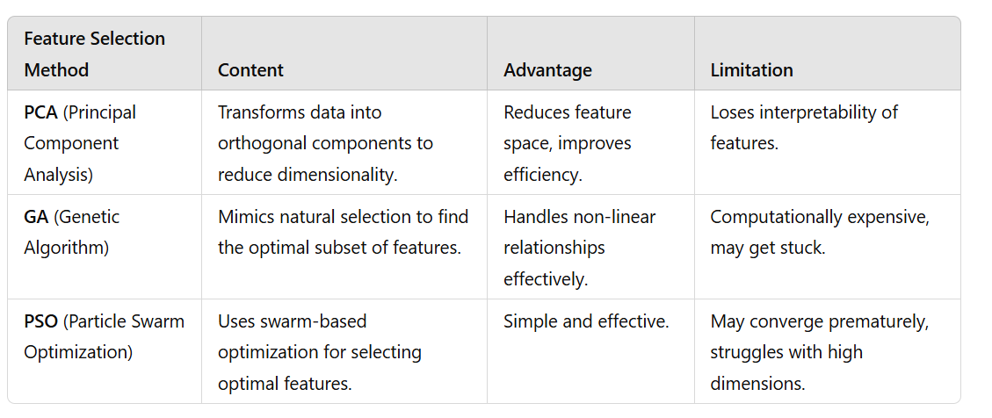
Feature Selection Methods

Slide 8
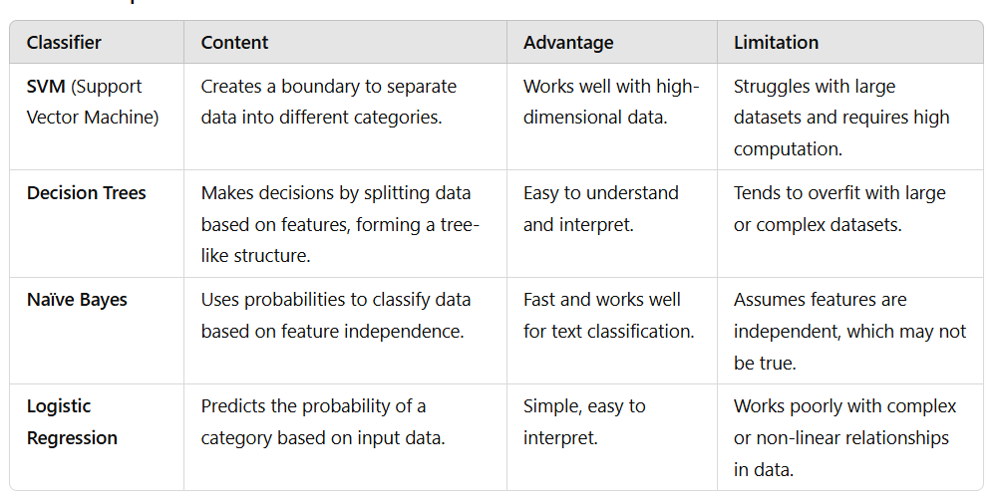
Traditional ML Classifiers

Slide 9
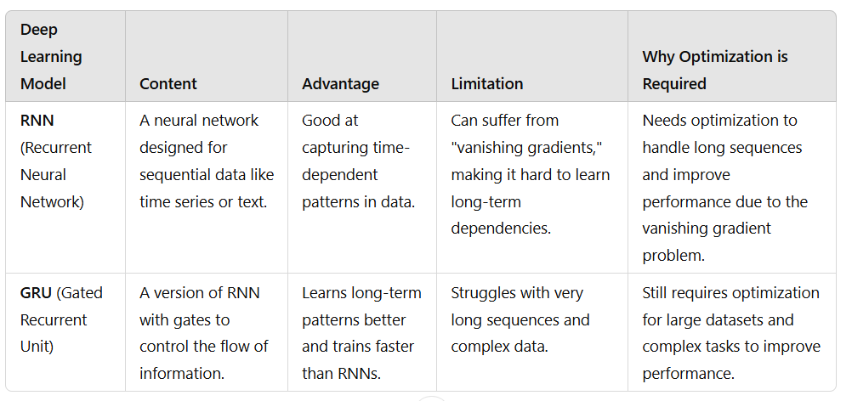
Deep learning model

Slide 10
Research Gaps and Limitations

Slide 11
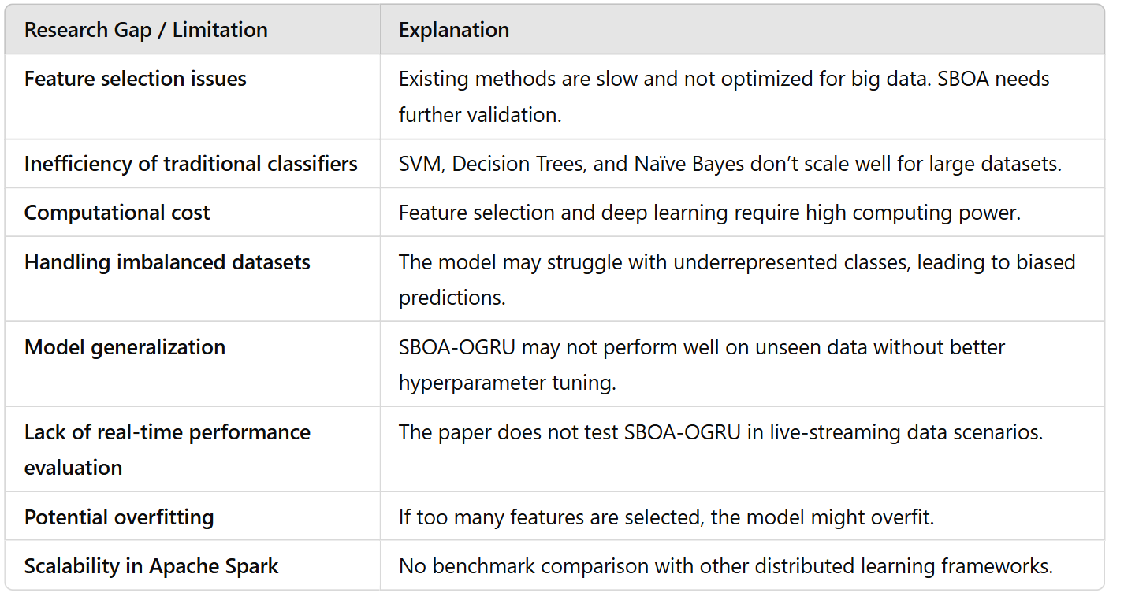
Research Gaps & Limitations

Slide 12
Proposed methods
Key Features
Feature Selection: SBOA selects the most relevant features.
Classification: OGRU enhances classification performance.
Optimization: Adam Optimizer fine-tunes hyperparameters.
Implementation: Apache Spark ensures scalability.
Why SBOA-OGRU? Reduces computational complexity Enhances feature selection efficiency Achieves better accuracy than ML & DL models Scales efficiently with Apache Spark

Slide 13
Sigmoid Butterfly Optimization Algorithm (SBOA)
The Sigmoid Butterfly Optimization Algorithm (SBOA) is inspired by the Butterfly Optimization Algorithm (BOA), mimicking butterfly foraging behavior. It introduces a binary transformation mechanism for feature selection, reducing dataset dimensionality to enhance computational efficiency and classification accuracy, especially in big data applications.
How SBOA Works? ✔ Global Search: Explores a large feature space to identify optimal subsets using fragrance-based updates. ✔ Local Search: Fine-tunes selected features for higher accuracy and efficient classification.

Slide 14
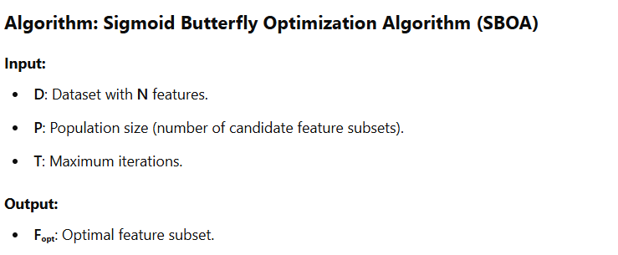

Slide 15
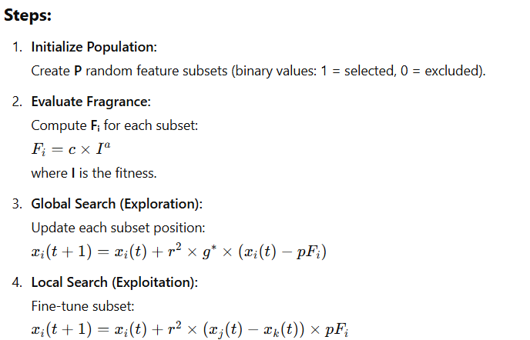

Slide 16
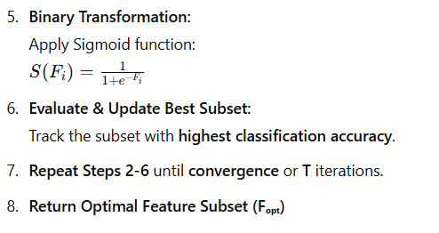
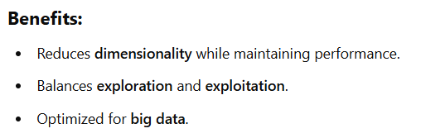

Slide 17
Adam optimizer
Adam (Adaptive Moment Estimation) is a popular optimization algorithm used in deep learning for fast convergence and adaptive learning rates. It combines the benefits of Stochastic Gradient Descent (SGD), Momentum, and RMSProp.
Key Features:
Adaptive Learning Rate: Adjusts step size for each parameter.
Momentum: Uses past gradients to accelerate convergence.
Bias Correction: Corrects initial bias in moment estimates.
Efficient: Works well with sparse gradients and large datasets.

Slide 18
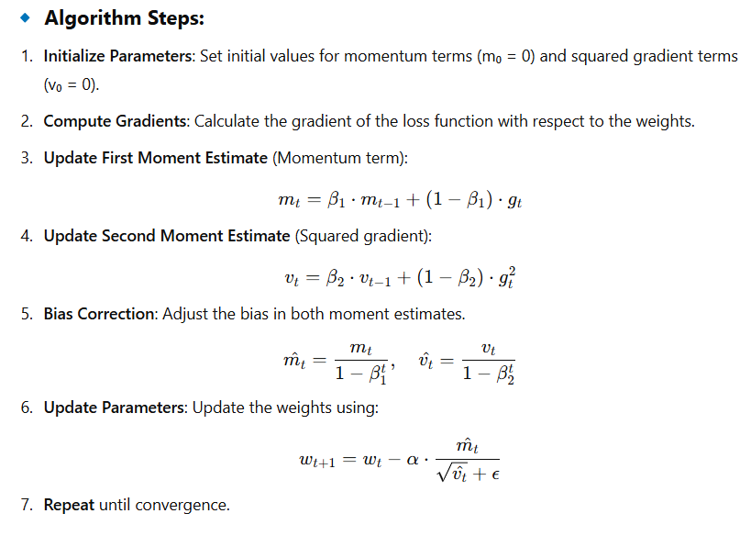

Slide 19
OGRU (Optimized Gated Recurrent Unit)
• It is improved GRU for efficient sequential data processing.
Key Features:
Memory Efficiency: Retains relevant information without vanishing gradients.
Reduced Parameters: Fewer computations than traditional RNNs.
Optimized with Adam: Faster convergence and improved learning.

Slide 20
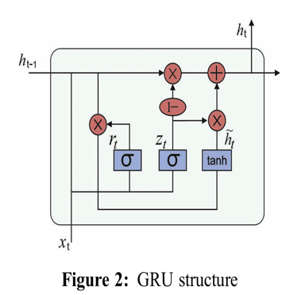
Gated Recurrent Unit (GRU) - Structure & Function
🔹GRU Components:
Reset Gate (rₜ): Determines how much past information to forget.
Update Gate (zₜ): Controls the balance between past and new information.
Candidate Activation (h̃ₜ): Computes new memory using tanh.
🔹 Working: rₜ adjusts the influence of previous hidden state hₜ₋₁.
zₜ decides how much of hₜ₋₁ to retain.
The final state hₜ blends past and new information for optimal learning.
💡 GRU is computationally efficient and reduces vanishing gradient issues.

Slide 21
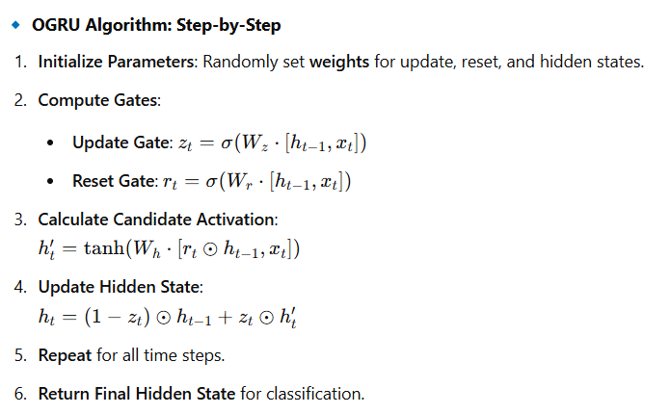

Slide 22
Experimentation
Experimental Setup and Evaluation Metrics
Content:
Datasets Used:
Epsilon Dataset: 400,000 training samples, 100,000 testing samples, 2000 features.
ECBDL14-ROS Dataset: 65 million training samples, 2.8 million testing samples, 631 features.
Implementation Environment:
Apache Spark for distributed computing.
Python with TensorFlow and Spark MLlib integration.
Evaluation Metrics:
Accuracy, AUC Score, Training Runtime, Feature Reduction Efficiency

Slide 23
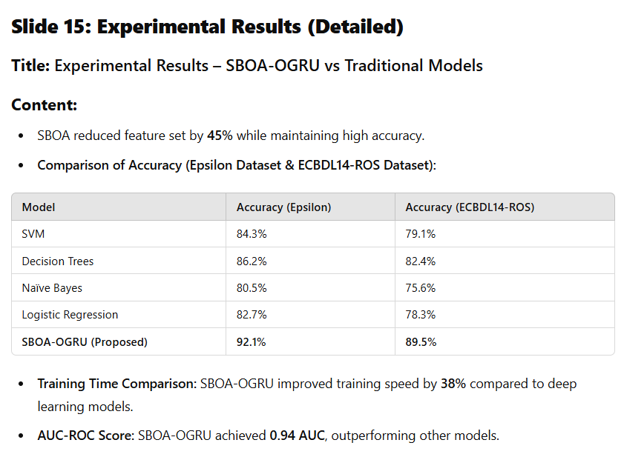

Slide 24
FUTURE WORK
Potential Improvements:
Density-Based Clustering: Integrate clustering techniques to improve feature selection.
Application to Other Domains: Test the model in healthcare, finance, and IoT.
Hyperparameter Optimization: Explore advanced optimization techniques for GRU.

Slide 25
CONCLUSION
🔹 Proposed SBOA-OGRU Model:
SBOA optimally selects relevant features.
OGRU improves classification accuracy.
Adam Optimizer fine-tunes GRU parameters.
🔹 Performance & Scalability:
Apache Spark ensures efficient Big Data processing.
Achieved 94.88% AUC on Epsilon & ECBDL14-ROS datasets.
🔹 Future Enhancements:
Density-based clustering for better classification.
Exploring Transformer models for further optimization.

Slide 26
References
Key References:
Khan et al. (2018) - Two-stage big data analytics framework.
Nair & Shetty (2018) - Spark-based machine learning for streaming data.
Hbibi & Barka (2016) - Big data frameworks and issues.

Slide 27
THANK YOU

